Slide 1
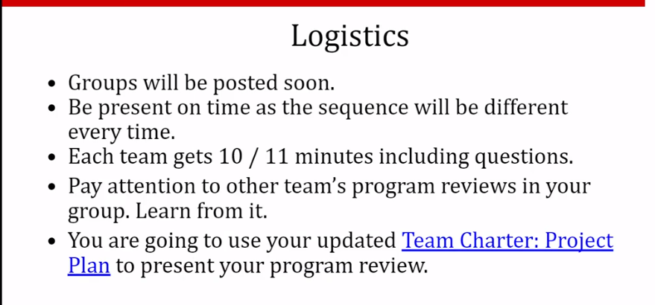
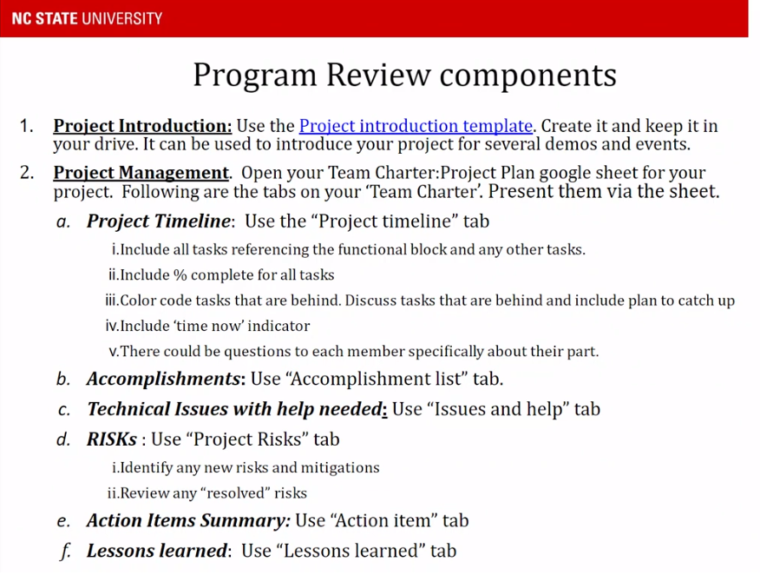
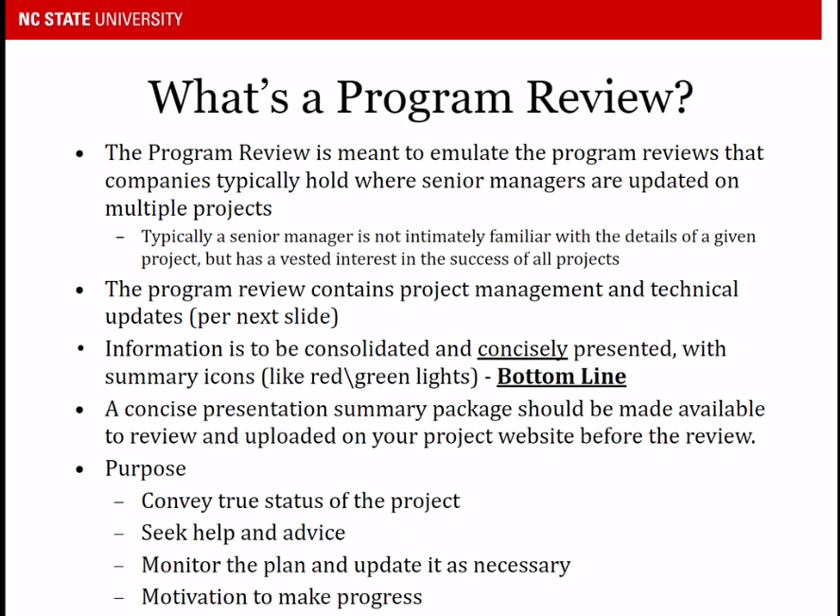

Slide 2
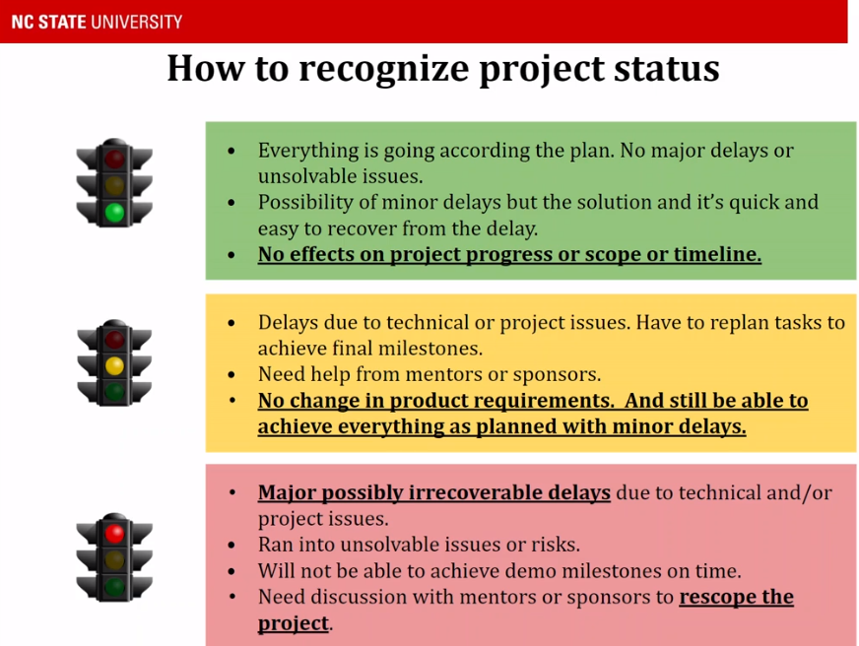
Choose 1 stoplight color to put on the introduction slide to qualify the status of the whole project

Slide 3
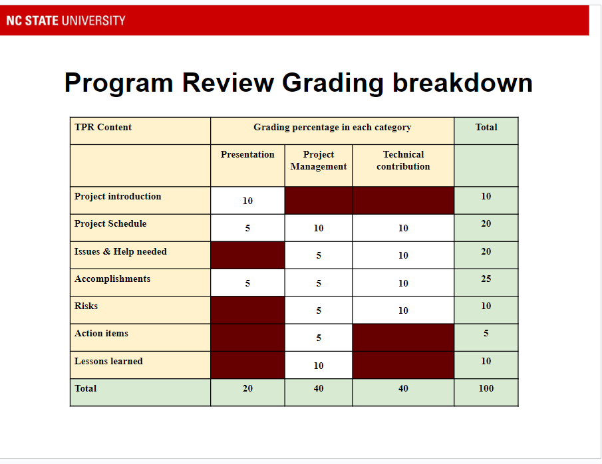
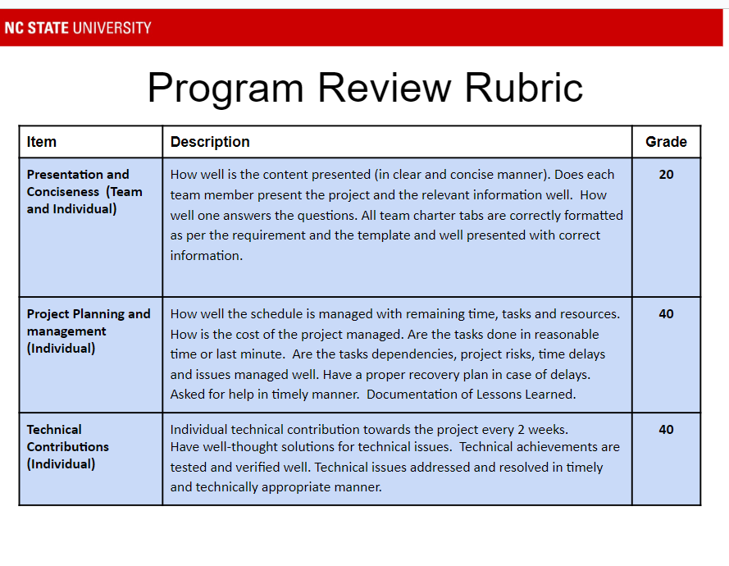

Slide 4
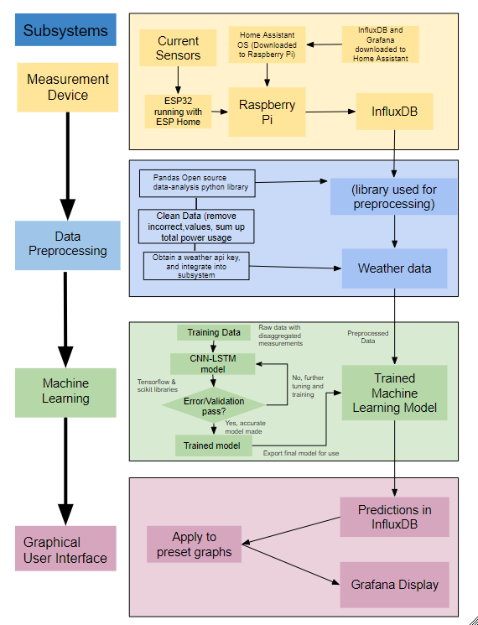

Project Introduction (Program Review 1)
Residential Power Disagreggation - Team 50
Team: Andrew Bailey, Ralph Cullom, Manny Harris, Labib Kasim
Sponsor: Huangjie Gong (ABB)
Key features:
Device measures lumped power usage of a household.
Data is wirelessly transmitted to a database
Weather data is added
Machine learning algorithm disaggregates loads
Information is displayed to the user
Key Requirements:
Inexpensive
Size
User interface
Target Customers
Homeowners & Property Managers
Project issues/bottlenecks:
-Weather history
-ESPHome network conn.
Notes:
Ralph
Key Features
Our device measures the total power usage of a household and then uses software to predict how much power each individual appliance used before displaying that info to the user. After using current transformers to measure the total power, the measurements are wirelessly sent to a database. Then, a weather API adds the temperature for the time the measurement was taken, and a machine learning algorithm disaggregates the total power into separate loads. After this is done, the total and disaggregated loads are displayed to the user on a graphical interface
Key Requirements
Inexpensive - Our project differs from other devices in price, with an estimated final cost of the product under $100.
Size - device shall be small enough to fit inside a residential distribution panel
User interface - The user should be able to comprehend the data displayed without a technical background
Target Customers & Usage
Homeowners using this device will be able to understand their power usage and can find which appliances may be upgraded to save money on their electricity bill. Property managers could do this on a much larger scale if they have multiple housing units they maintain
Yellow stoplight
Having some issues connecting ESP32 to network, should be able to resolve this issue fairly easily
Have a weather API that can pull temperature history between a set of dates, unable to add temperature column to training data

Slide 5
Team Charter - Project 50
Project Schedule
Issues & Help needed
Accomplishments
Risks
Action Items
Lessons Learned

Slide 6
Accomplishments

Slide 7
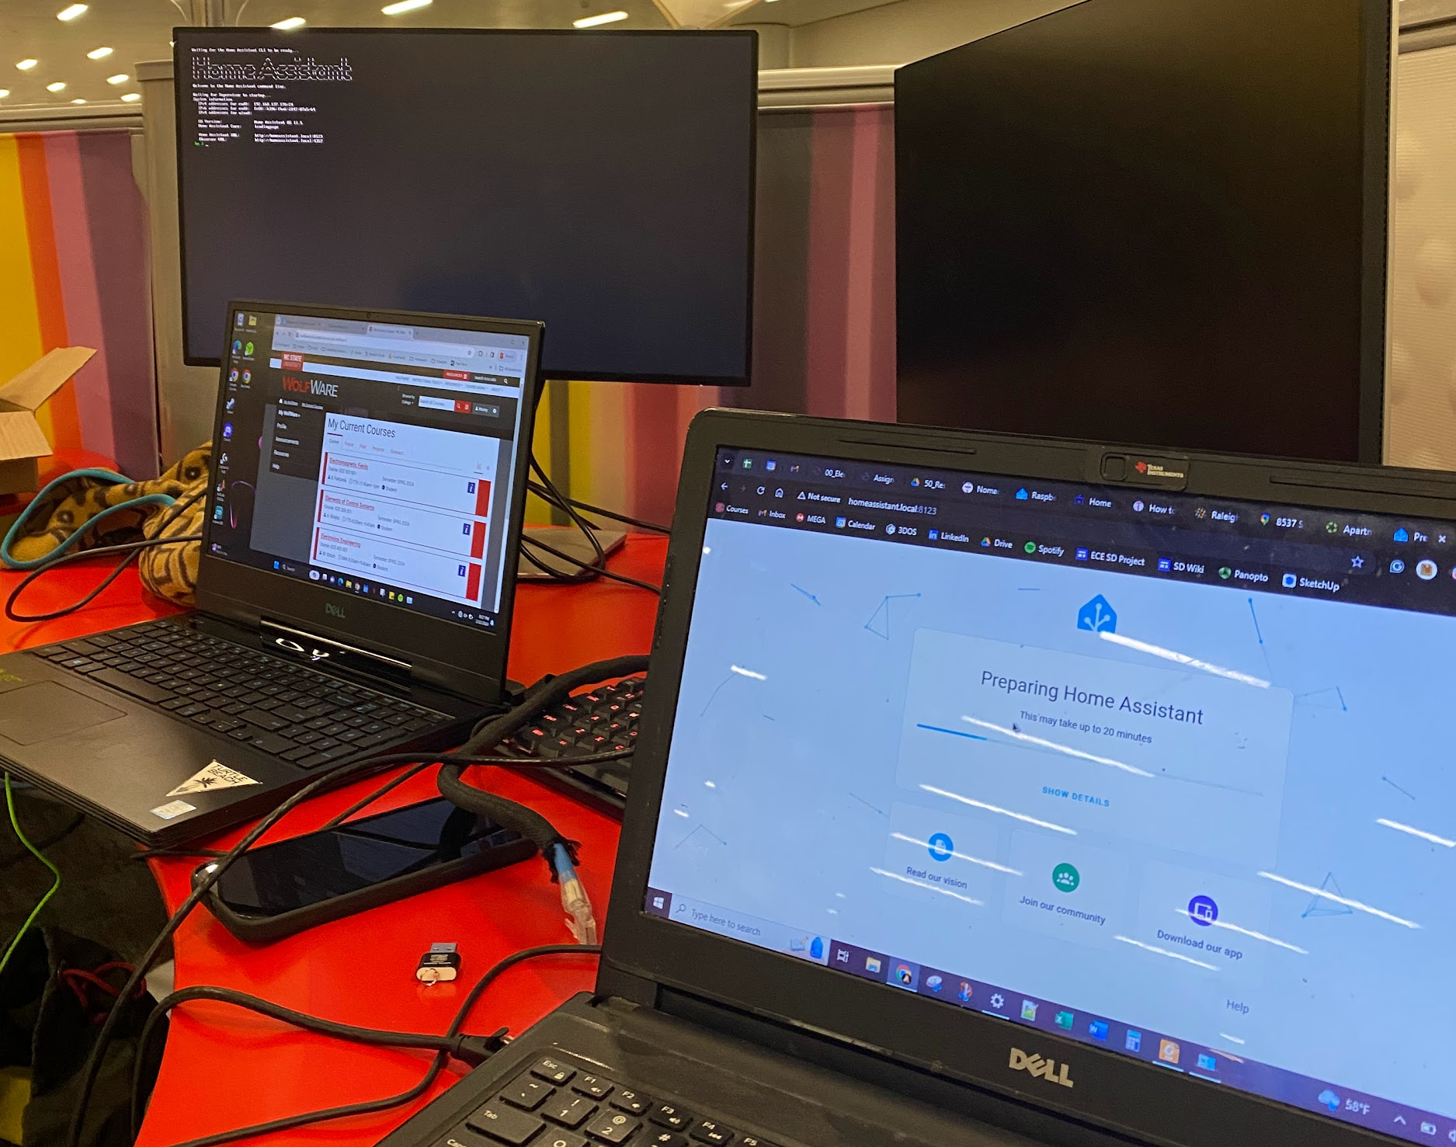
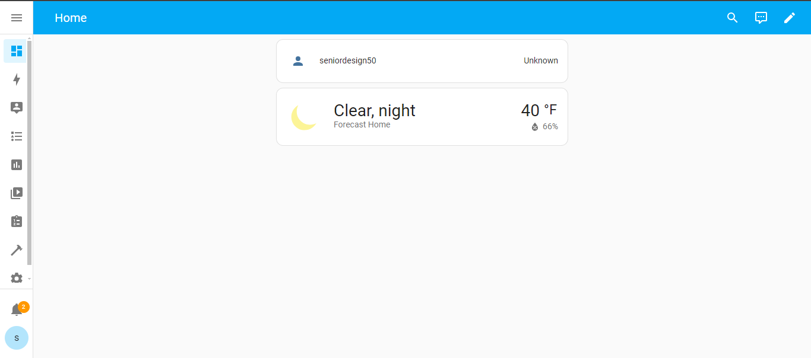
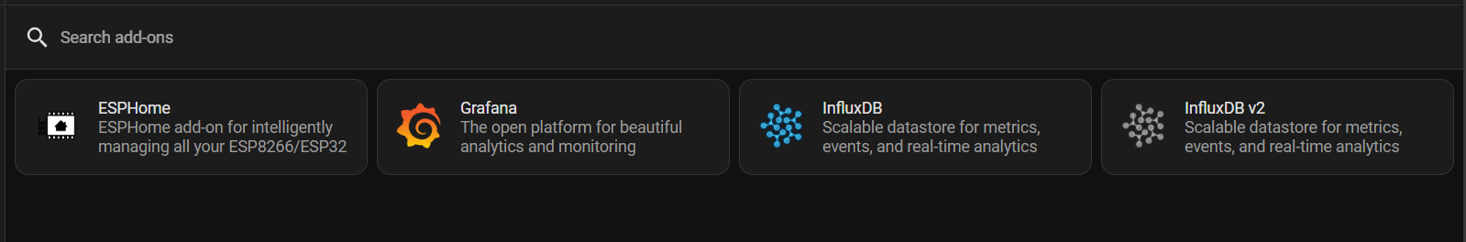
Home Assistant OS installed on RPi
Installed home assistant operating system and add-ons. (Grafana, ESPHome, InfluxDB)
-Manny & Andrew

Slide 8
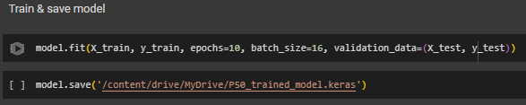

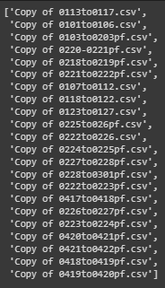
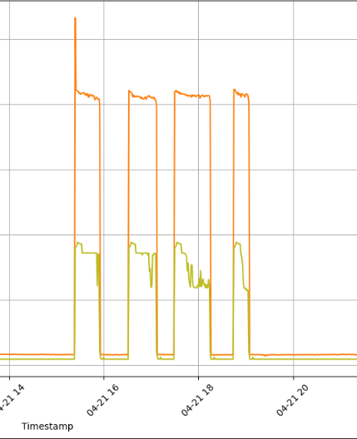
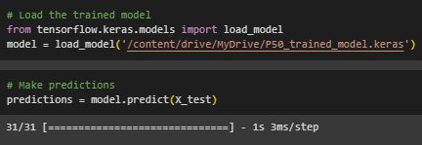
Trained and Exported Model
Consolidated 4 months of data to train a model and export it. Can import the model to use in a different environment which will be necessary to run it on the RPi
-Andrew
Files used

Slide 9
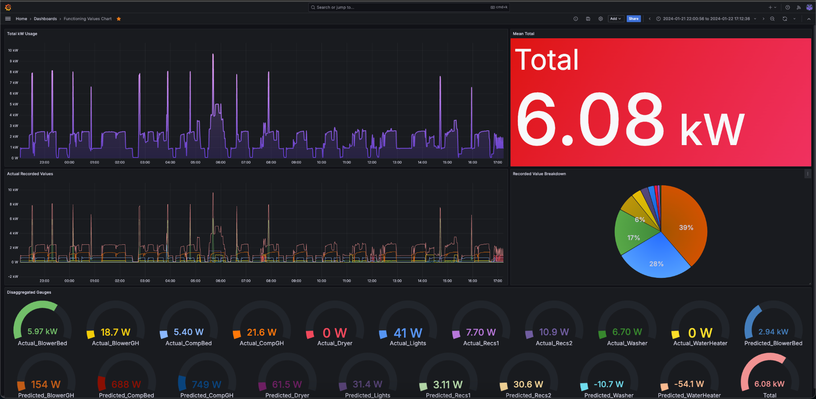
Improving Grafana Queries and Layout
Updating graph queries to be more specific
Working on including a graph with price points for gauge values
Ralph

Slide 10
Issues

Slide 11
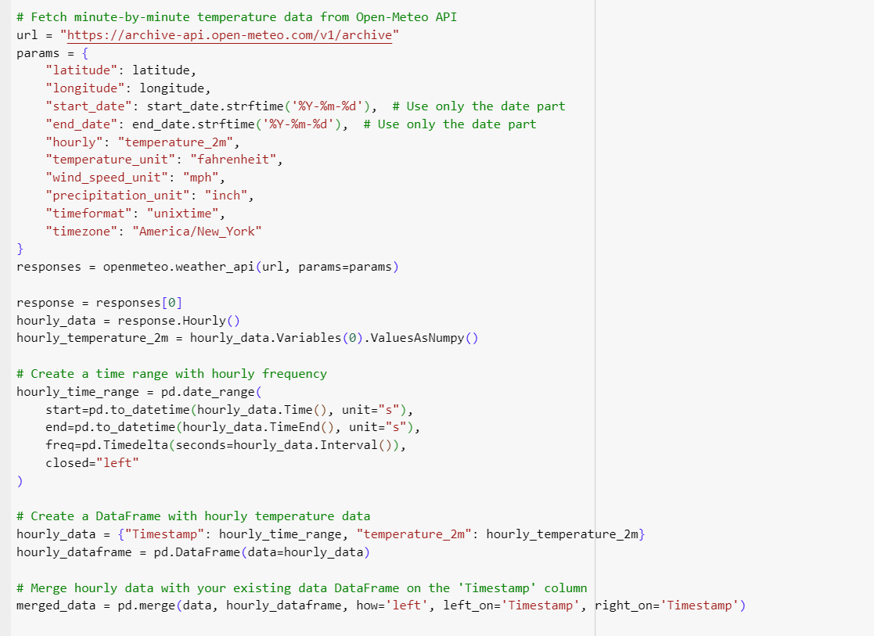
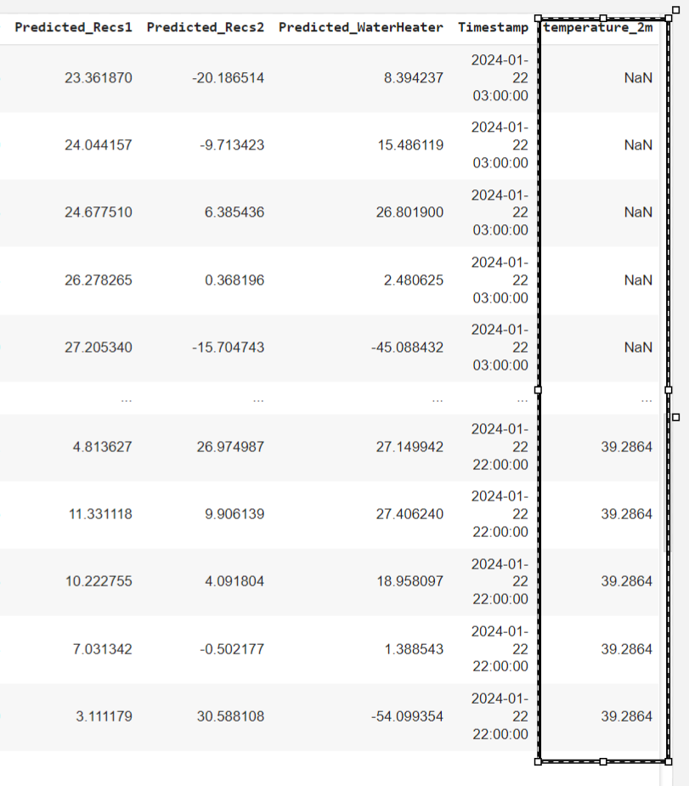
Weather API
Was able to pull temperature history with some issues and add it as a column to the rest of the data, in addition to already
having real-time weather data and future temperature predictions.
Notes:
predictions.

Slide 12
Questions
and
Discussion
Notes:
Slide template from slides.com

